Slide 1
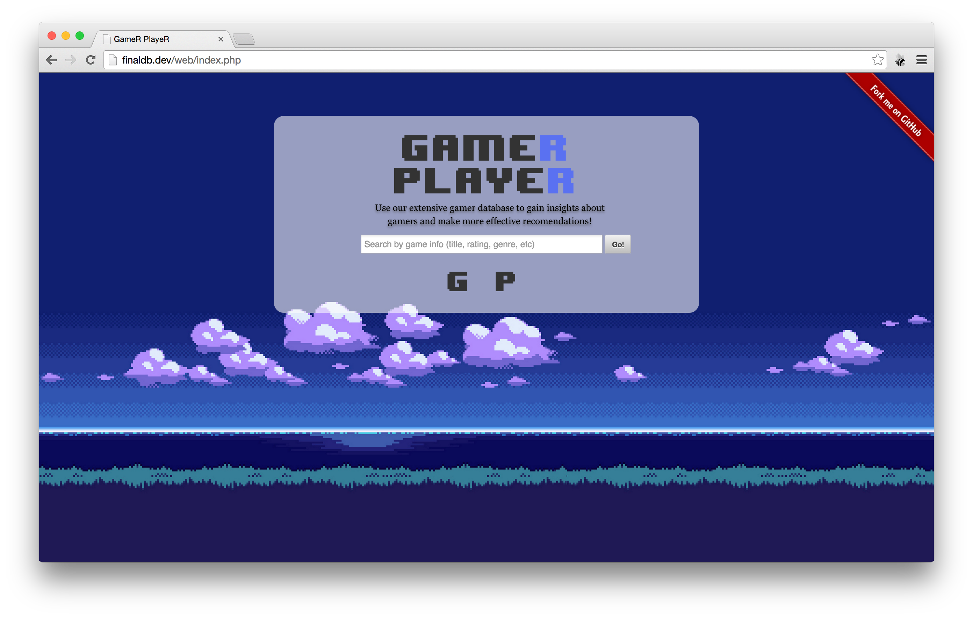
GameR PlayeR
Matt Klein David Fu
Manny Lopez

Slide 2
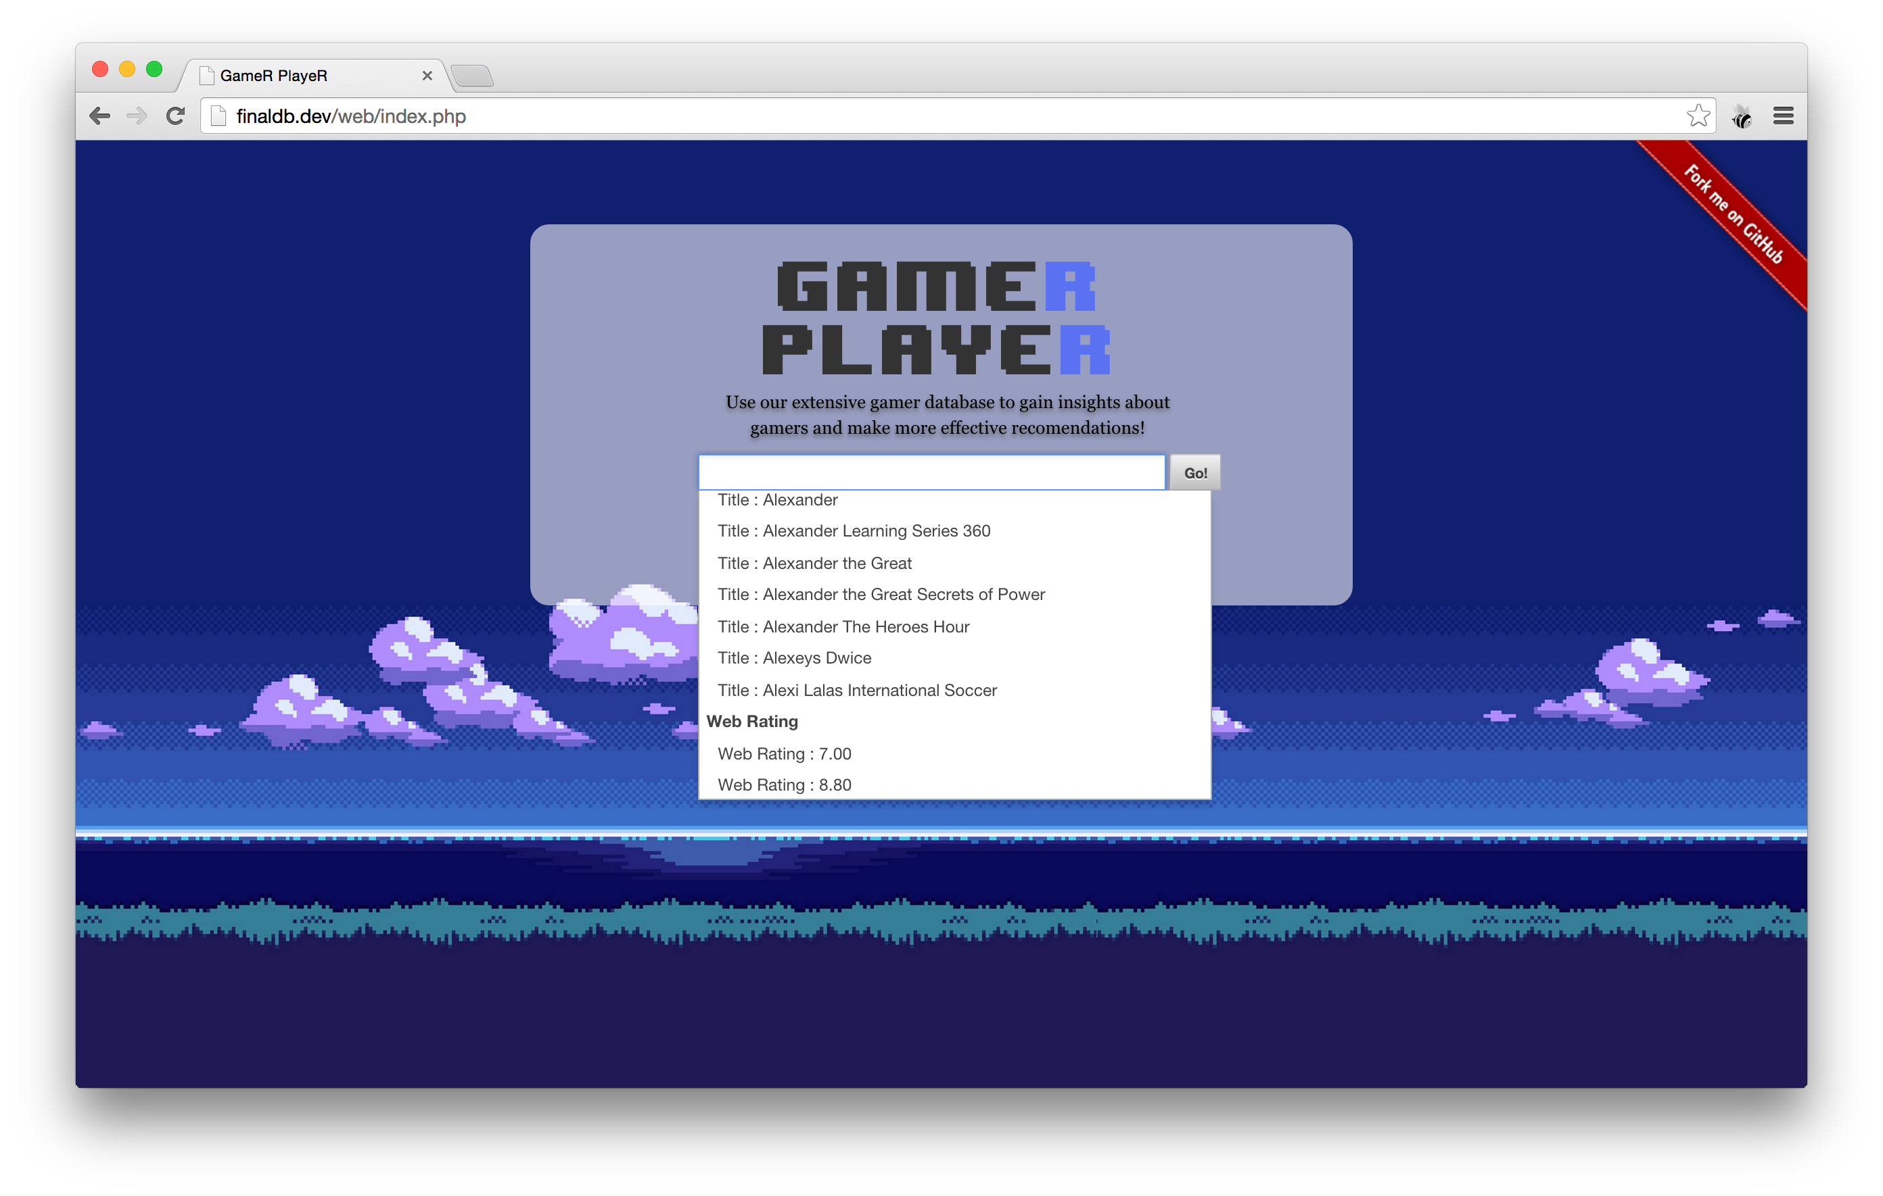
Features
Beautiful, working fronted
Jquery plugins: DataTables, Avgrund, ChosenJS
Multi-search, with a query taking the maximum set of data
Ability to see every player’s information easily

Slide 3
Multiple Tables
Games owned per player
Specific game info:
Release, Ratings, Developer, Publisher, Genres
All real data for games!
Players have names, genders, incomes, preferred genres and more

Slide 4
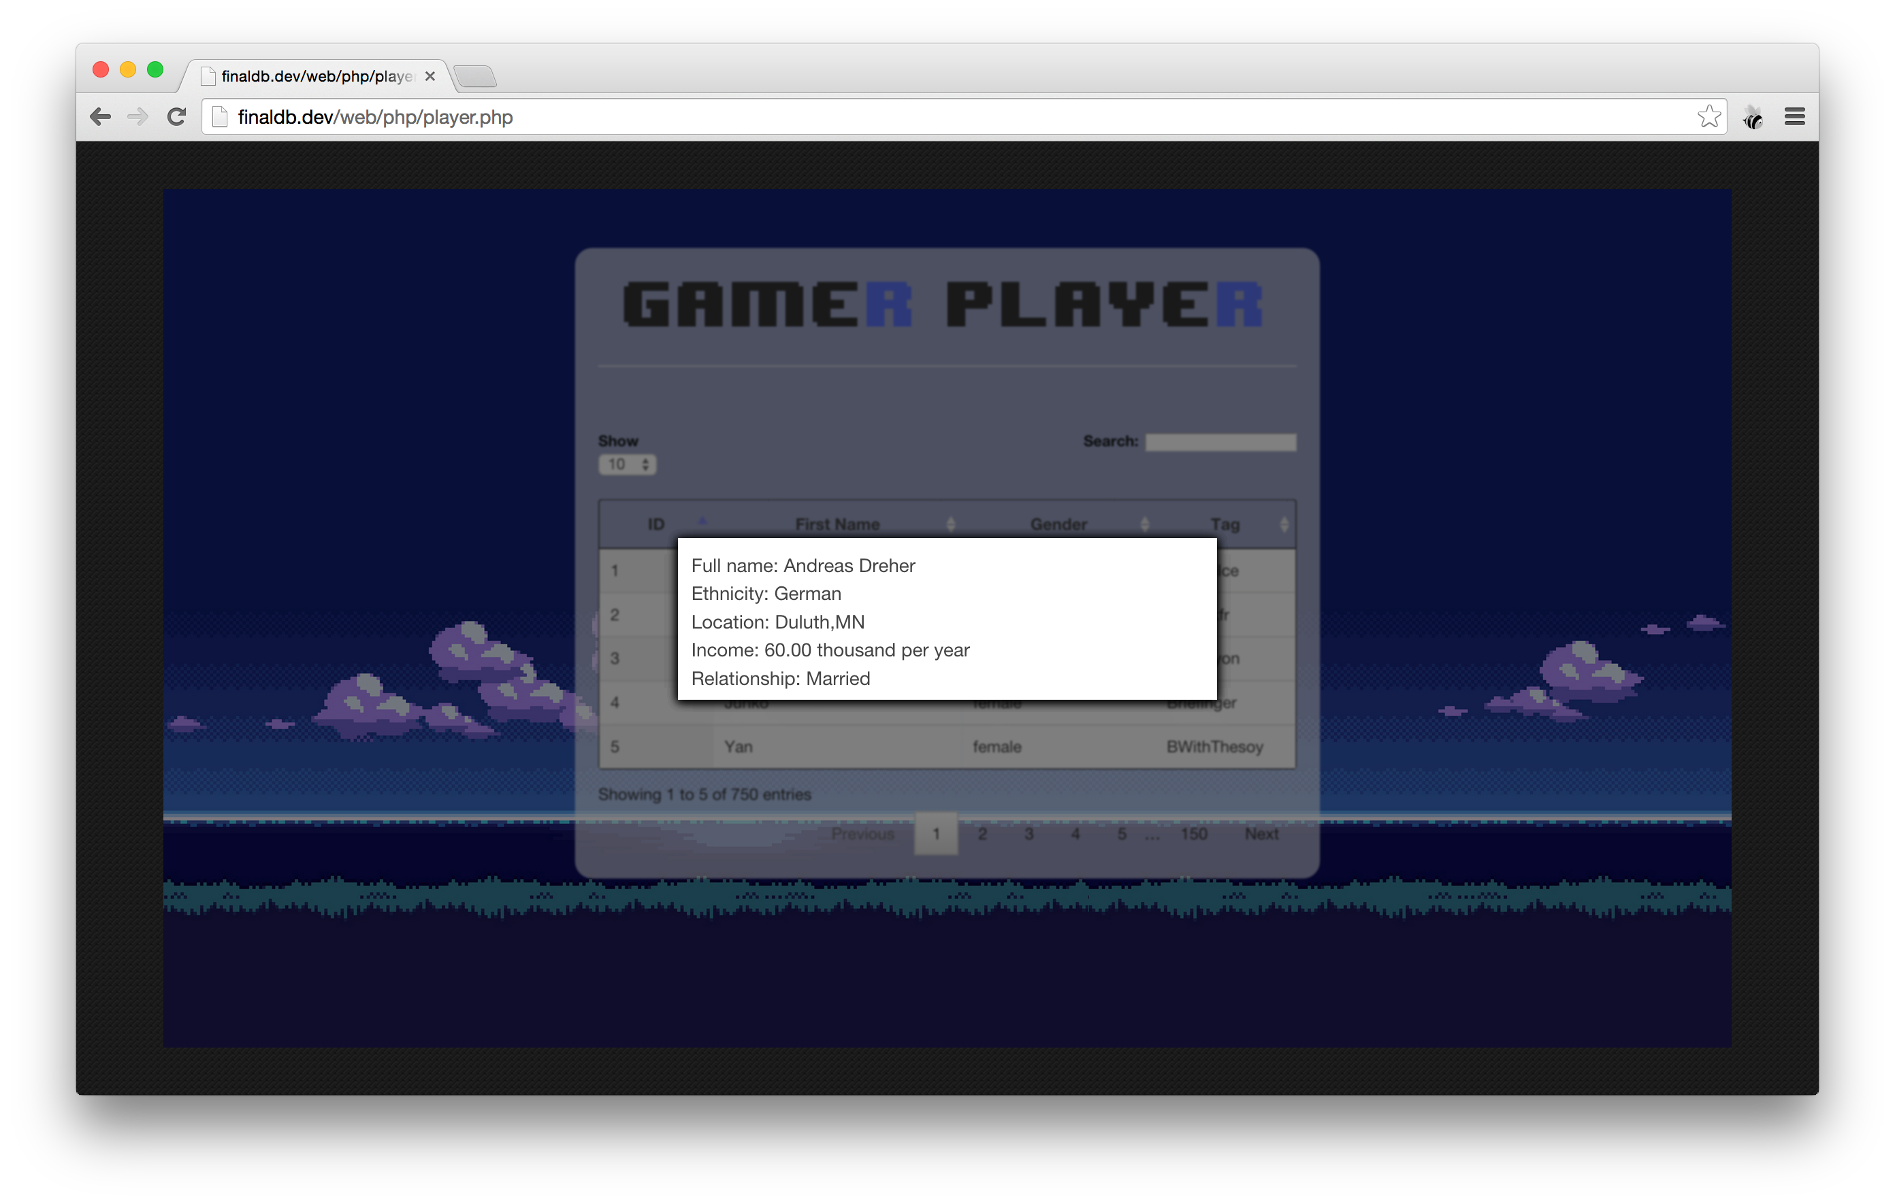
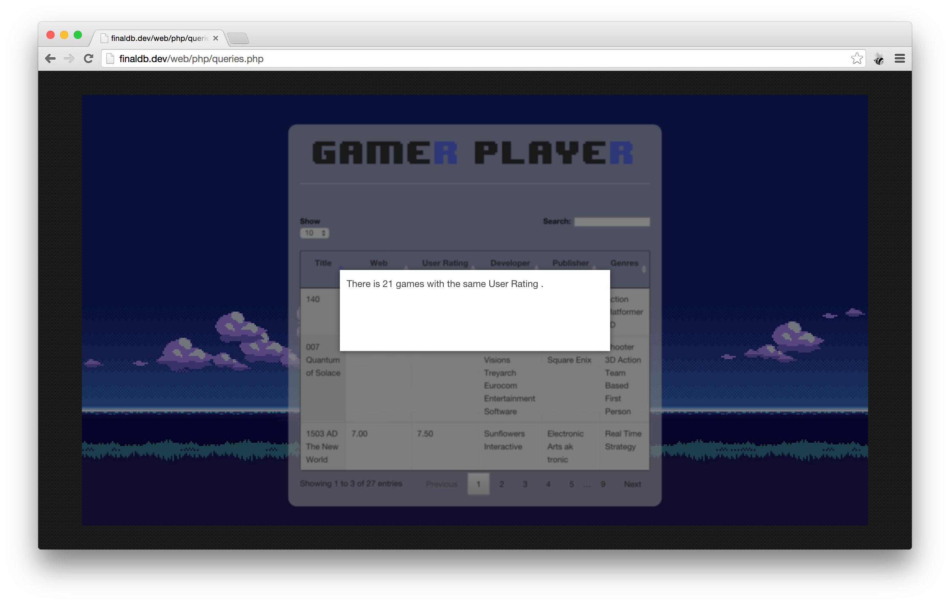
What can we do with it?
Recommend the BEST game that is unowned for a player (provided that genre exists) and display that user’s full information
View numbers related to games (How many games have the same rating?)

Slide 5
No info?
No problem! Data is easily readable to whoever requests the data
If there is no data, we simply state there is nothing

Slide 6
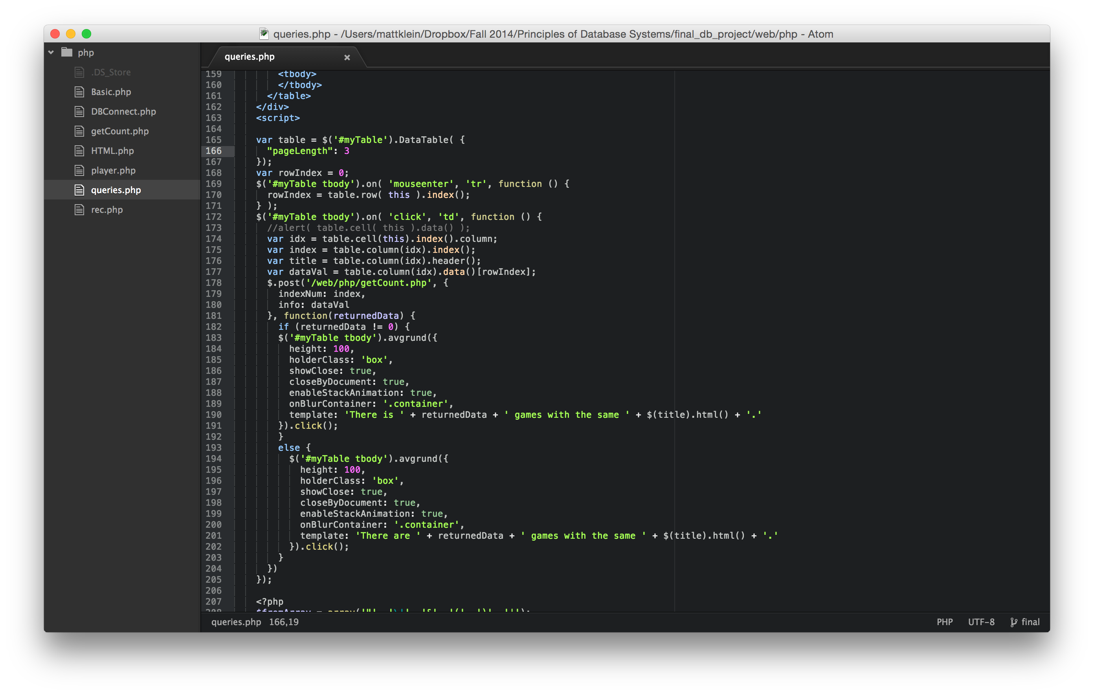
How do we get this data?
To find a recommended game, just click on that player’s Tag
To see player information, just click on that player’s ID
To see any information for a game, just click on any data in a row

Slide 7
How is it fast with so much data?
Our search box is multithreaded
Getting information for a game/player, we get the row on hover, before you even click!

Slide 8
Why do you need it?
Your business can make more effective recommendations for purchases at your store!

